Slide 1

God’s Love When We Stumble
James 3:2
Notes:
Eddie Williams ~ June 14, 2015 (Eloy AM)
~ July 16, 2017 (Eloy AM)
~ February 9, 2020 (Eloy AM)
~ October 23, 2022 (Eloy AM)
~ March 26, 2023 (Eloy AM)
~ April 26, 2026 (Eloy AM)

Slide 2
James 3:2 (AMP)
For we all often stumble and fall and offend in many things. And if anyone does not offend in speech [never says the wrong things], he is a fully developed character and a perfect man, able to control his whole body and to curb his entire nature.

Slide 3
Stumble:
To Offend
To Err
To Fall
to Sin

Slide 4
God’s Love When We Stumble
We all Stumble in Many Ways
“We,” Includes the Prophets and Apostles
Stumbling and Offenses Will Happen in the Body
We All Must Pray to Watch Our Tongues

Slide 5
Point #1: We all Stumble in Many Ways
I John 1:8 (AMP)
James 2:10 (AMP)

Slide 6
I John 1:8 (AMP)
If we say we have no sin [refusing to admit that we are sinners], we delude and lead ourselves astray, and the Truth [which the Gospel presents] is not in us [does not dwell in our hearts].

Slide 7
James 2:10 (AMP)
For whosoever keeps the Law [as a] whole but stumbles and offends in one [single instance] has become guilty of [breaking] all of it.

Slide 8
Point #2: “We,” Includes the Prophets and Apostles
Numbers 20:10-11 (NIV)
II Samuel 11:1-4 (NIV)
Galatians 2:11-14 (KJV)

Slide 9
Moses Stumbled in Anger
Numbers 20:10-11 (NIV)
10 He and Aaron gathered the assembly together in front of the rock and Moses said to them, “Listen, you rebels, must we bring you water out of this rock?”

Slide 10
Numbers 20:10-11 (NIV)
11 Then Moses raised his arm and struck the rock twice with his staff. Water gushed out, and the community and their livestock drank the earth.

Slide 11
David Stumbled in Lust
II Samuel 11:1-4 (NIV)
1 In the spring, at the time when kings go off to war, David sent Joab out with the king’s men and the whole Israelite army. They destroyed the Ammonites and besieged Rabbah.

Slide 12
II Samuel 11:1-4 (NIV)
But David remained in Jerusalem.
2 One evening David got up from his bed and walked around on the roof of the palace. From the roof he saw a woman bathing. The woman was very beautiful,

Slide 13
II Samuel 11:1-4 (NIV)
3 and David sent someone to find out about her. The man said, “She is Bathsheba, the daughter of Eliam and the wife of Uriah the Hittite.”
4 Then David sent messengers to get her.

Slide 14
II Samuel 11:1-4 (NIV)
She came to him, and he slept with her. (Now she was purifying herself from her monthly uncleanness.) Then she went back home.

Slide 15
Peter Stumbled in Racism
Galatians 2:11-14 (KJV)
11 But when Peter was come to Antioch, I withstood him to the face, because he was to be blamed.
12 For before that certain came from James, he did eat with the Gentiles:

Slide 16
Galatians 2:11-14 (KJV)
but when they were come, he withdrew and separated himself, fearing them which were of the circumcision. 13 And the other Jews dissembled likewise with him; insomuch that Barnabas also was carried away with their dissimulation.

Slide 17
Galatians 2:11-14 (KJV)
14 But when I saw that they walked not uprightly according to the truth of the gospel, I said unto Peter before them all, If thou, being a Jew, livest after the manner of Gentiles, and not
as do the Jews, why compellest thou the Gentiles to live as do the Jews?

Slide 18
Point #3: Stumbling and Offenses Will Happen in the Body
Philippians 4:2-4 (AMP)
Acts 15:36-40 (KJV)
Matthew 18:6-7 (KJV)

Slide 19
Philippians 4:2-4 (AMP)
2 I entreat and advise Euodia and I entreat and advise Syntyche to agree and to work in harmony in the Lord.
3 And I exhort you too, [my] genuine yokefellow,

Slide 20
Philippians 4:2-4 (AMP)
help these [two women to keep on cooperating], for they have toiled along with me in [the spreading of] the good news (the Gospel),

Slide 21
Philippians 4:2-4 (AMP)
as have Clement and the rest of my fellow workers whose names are in the Book of Life. 4 Rejoice in the Lord always [delight, gladden yourselves in Him]; again I say, Rejoice!

Slide 22
Acts 15:36-40 (KJV)
36 And some days after Paul said unto Barnabas, Let us go again and visit our brethren in every city where we have preached the word of the Lord, and see how they do.

Slide 23
Acts 15:36-40 (KJV)
37 And Barnabas determined to take with them John, whose surname was Mark. 38 But Paul thought not good to take him with them, who departed from them from Pamphylia, and went not with them to the work.

Slide 24
Acts 15:36-40 (KJV)
39 And the contention was so sharp between them, that they departed asunder one from the other: and so Barnabas took Mark, and sailed unto Cyprus;

Slide 25
Acts 15:36-40 (KJV)
40 And Paul chose Silas, and departed, being recommended by the brethren unto the grace of God.

Slide 26
Matthew 18:6-7 (KJV)
6 But whoso shall offend one of these little ones which believe in me, it were better for him that a millstone were hanged about his neck, and that he were drowned in the depth of the sea.

Slide 27
Matthew 18:6-7 (KJV)
7 Woe unto the world because of offences! for it must needs be that offences come; but woe to that man by whom the offence cometh!

Slide 28
Point #4: We All Must Pray to Watch Our Tongues
James 3:2-10 (AMP)
James 1:26 (AMP)
Proverbs 10:19 (KJV)
Proverbs 21:23 (AMP)

Slide 29
James 3:2-10 (AMP)
2 For we all often stumble and fall and offend in many things. And if anyone does not offend in speech [never says the wrong things],

Slide 30
James 3:2-10 (AMP)
he is a fully developed character and a perfect man, able to control his whole body and to curb his entire nature.

Slide 31
James 3:2-10 (AMP)
3 If we set bits in the horses’ mouths to make them obey us, we can turn their whole bodies about.
4 Likewise, look at the ships:

Slide 32
James 3:2-10 (AMP)
though they are so great and are driven by rough winds, they are steered by a very small rudder wherever the impulse of the helmsman determines.

Slide 33
James 3:2-10 (AMP)
5 Even so the tongue is a little member, and it can boast of great things. See how much wood or how great a forest a tiny spark can set ablaze!

Slide 34
James 3:2-10 (AMP)
6 And the tongue is a fire. [The tongue is a] world of wickedness set among our members,

Slide 35
James 3:2-10 (AMP)
contaminating and depraving the whole body and setting on fire the wheel of birth (the cycle of man’s nature), being itself ignited by hell (Gehenna).

Slide 36
James 3:2-10 (AMP)
7 For every kind of beast and bird, of reptile and sea animal, can be tamed and has been tamed by human genius (nature).

Slide 37
James 3:2-10 (AMP)
8 But the human tongue can be tamed by no man. It is a restless (undisciplined, irreconcilable) evil, full of deadly poison.

Slide 38
James 3:2-10 (AMP)
9 With it we bless the Lord and Father, and with it we curse men who were made in God’s likeness!

Slide 39
James 3:2-10 (AMP)
10 Out of the same mouth come forth blessing and cursing. These things, my brethren, ought not to be so.

Slide 40
James 1:26 (AMP)
If anyone thinks himself to be religious (piously observant of the external duties of his faith) and does not bridle his tongue but deludes his own heart, this person’s religious service is worthless (futile, barren).

Slide 41
Proverbs 10:19 (KJV)
In the multitude of words there wanteth not sin: but he that refraineth his lips is wise.

Slide 42
Proverbs 21:23 (AMP)
He who guards his mouth and his tongue keeps himself from troubles.

Slide 43
A sharp tongue is a weapon, no less as effective as a pointed spear or a sword honed to a razor's edge. A sharp tongue has no place among the fruit of the Spirit (Galatians 5:22-23). It does not express love, spread joy or promote peace.

Slide 44
It shows no patience, kindness or goodness in its words. It betrays faithfulness and gentleness, and most of all, it shows no measure of self-control. My sharp tongue has been a contradiction to the convictions I have expressed nearly all my life.

Slide 45
I never saw it until I had to come face to face with the jabs, slices, and pricks of other sharp tongues, and to feel the fires they started within me.

Slide 46
I would beg the Father for understanding, of why such communication should exist and why I should receive it with such bitterness—until I finally saw, as David did, that I am the guilty one.

Slide 47
Psalm 103:9-11 (KJV)
9 He will not always chide: neither will he keep his anger for ever.
10 He hath not dealt with us after our sins; nor rewarded us according to our iniquities.

Slide 48
Psalm 103:9-11 (KJV)
11 For as the heaven is high above the earth, so great is his mercy toward them that fear him.

Slide 49
Lamentations 3:22 (KJV)
It is of the LORD'S mercies that we are not consumed, because his compassions fail not.

Slide 50
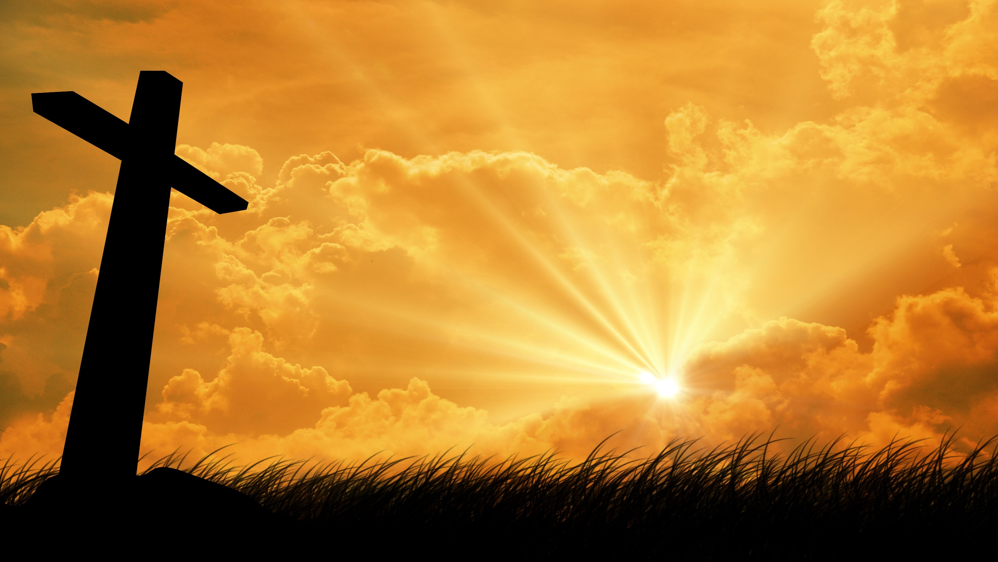
…that Christ died for our sins according to the scriptures;
And that he was buried, and that he rose again the third day according to the scriptures:

Slide 51
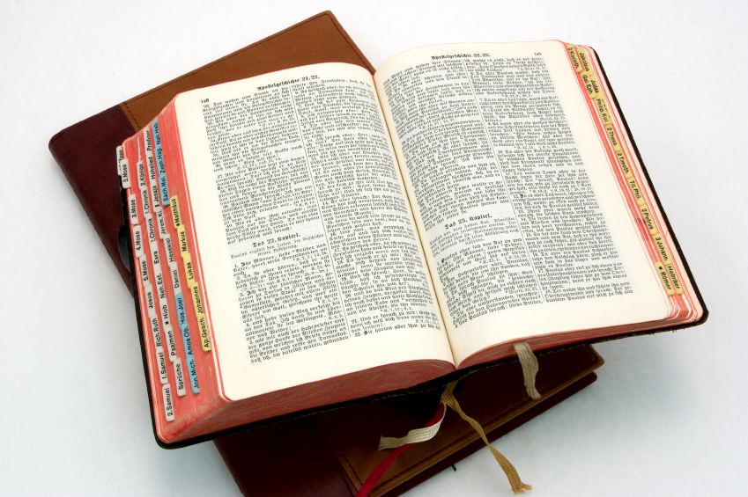
Hear: Romans 10:17
So then faith cometh by hearing, and hearing by the word of God.

Slide 52
Believe: Hebrews 11:6
But without faith it is impossible to please him: for he that cometh to God must believe that he is, and that he is a rewarder of them that diligently seek him.

Slide 53
Repent: Luke 13:3
I tell you, Nay: but, except ye repent, ye shall all likewise perish.

Slide 54
Confess: Matthew 10:32-33
32 Whosoever therefore shall confess me before men, him will I confess also before my Father which is in heaven.
33 But whosoever shall deny me before men, him will I also deny before my Father which is in heaven.

Slide 55
Baptize: Acts 22:16
And now why tarriest thou? arise, and be baptized, and wash away thy sins, calling on the name of the Lord.

